Slide 1

Assignment
23-04-25

Slide 2
Dumps
A "dump" refers to a runtime error that causes the system to terminate a program and generate a detailed error report called a Short Dump or ABAP Runtime Error.
These dumps are logged in the SAP system and can be analyzed using:
T-code: ST22 (ABAP Runtime Error Analysis).
Types of dumps:
Internal errors
Installation and environment dumps
Resource related error
Error in application program
Dumps related to sap basis

Slide 3
Dumps
A dump is an automatic error log generated by the SAP system when an ABAP program crashes.
It provides technical details about the error, such as:
Error type, Error message, Program name, Line number
Variable values at the time of the error
You can view dumps using T-Code ST22.
Types of dumps:
Internal errors
Installation and environment dumps
Resource related error
Error in application program
Dumps related to sap basis

Slide 4
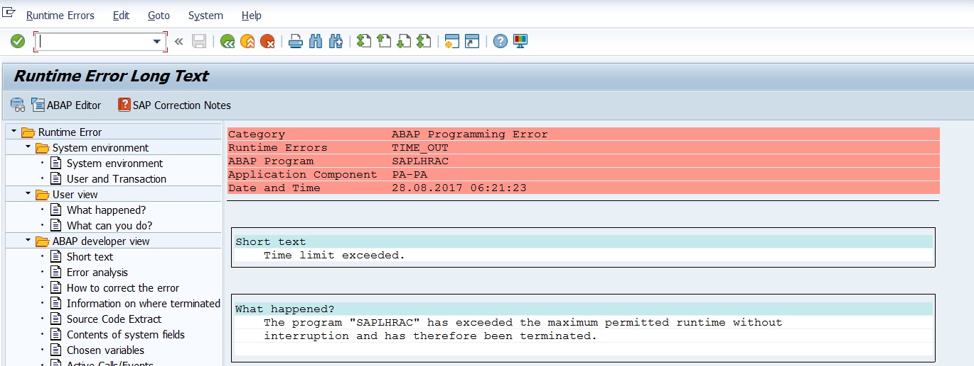
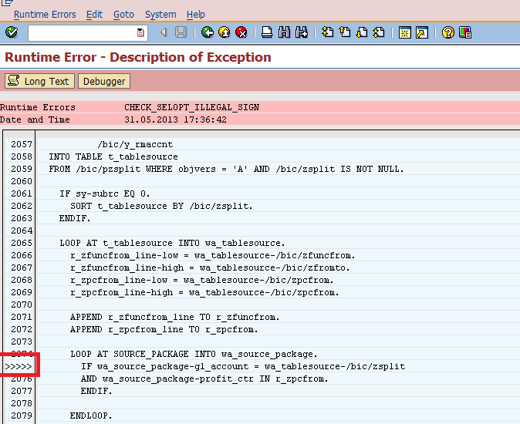

Slide 5
Internal dumps
Description: These dumps occur due to issues within the SAP kernel or core system components.
They are typically caused by bugs, inconsistencies, or unexpected behavior in the SAP system's internal logic.
Common Causes:
SAP kernel bugs or outdated kernel versions.
Memory corruption or invalid data processing.
Issues with database connectivity or internal system tables.
Examples:
SYSTEM_NO_MEMORY: Memory allocation failure.
TABLE_INVALID_INDEX: Accessing an invalid table index.

Slide 6
Installation and Environment dumps
Description: These dumps are related to issues in the SAP system setup, configuration, or environment, such as incorrect installations, missing dependencies, or incompatible hardware/software.
Common Causes:
Incorrect or incomplete SAP installation.
Missing or misconfigured environment variables (e.g., PATH, JAVA_HOME).
Incompatible operating system or database versions.
Insufficient disk space or file system permissions.
Examples:
SYSTEM_CORE_DUMPED: System crash due to environment issues.
DBIF_RSQL_SQL_ERROR: Database connection failure during installation.

Slide 7
Resource-Related Errors/dumps
Description: These dumps occur when the SAP system runs out of critical resources like memory, CPU, disk space, or work processes.
Common Causes:
Insufficient memory allocation (e.g., low heap memory, paging space).
High system load or too many active users/processes.
Insufficient disk space for logs or temporary files.
Overloaded work processes (e.g., DIA, BTC, or UPD processes).
Examples:
TSV_TNEW_PAGE_ALLOC_FAILED: Memory allocation failure for internal tables.
SYSTEM_NO_ROLL: Roll memory exhausted.
CALL_FUNCTION_NO_DEST: RFC destination resource issue.

Slide 8
Errors/dumps in Application Program
Description: These dumps are caused by issues in custom or standard ABAP programs, such as coding errors, incorrect logic, or improper handling of data.
Common Causes:
Syntax errors or logical errors in ABAP code.
Missing or incorrect input data validation.
Incorrect use of function modules, BAPIs, or database operations.
Incompatible changes after system upgrades.
Examples:
SYNTAX_ERROR: Syntax error in an ABAP program.
CX_SY_ARITHMETIC_OVERFLOW: Arithmetic overflow during calculation.
MESSAGE_TYPE_X: Generic termination with a custom message.

Slide 9
General Steps to Resolve Any Dump
Go to ST22 → Check today's and yesterday’s dumps.
Read the short text and long text: Focus on the ABAP Program, line number, and variables.
Use SM21 for related system logs.
Check for any active background jobs in SM37.
Search for relevant SAP Notes using keywords and error IDs.
Debug the program in SE38/SE80 if it’s custom.
Apply SAP Notes using SNOTE if a fix is available.
Consult BASIS or ABAP teams based on the type of error.

Slide 10
Key Transactions for Dump Analysis and Resolution
ST22: Analyze ABAP runtime errors (dumps).
SM21: View system logs for additional context.
SM50/SM66: Monitor work processes and system load.
ST06: Check OS-level resource usage (CPU, memory, disk).
SE80/SE38: Debug and correct ABAP programs.
SM59: Manage RFC connections.
SM37: Monitor background jobs.
SM12: Check and resolve lock entries.
DB02/ST04: Monitor database performance.
RZ10/RZ11: Manage system profile parameters.

Slide 11
Thank you
Presented by S. Vinish

